Slide 1
DTI Course
Bring your computer and you will be guided through the steps to reconstruct the white matter fibers of the brain, inspect fibers reaching gray matter nuclei, measure fractional anisotropy, parallel and perpendicular diffusivity
HANDS ON APPROACH !!!

Slide 2

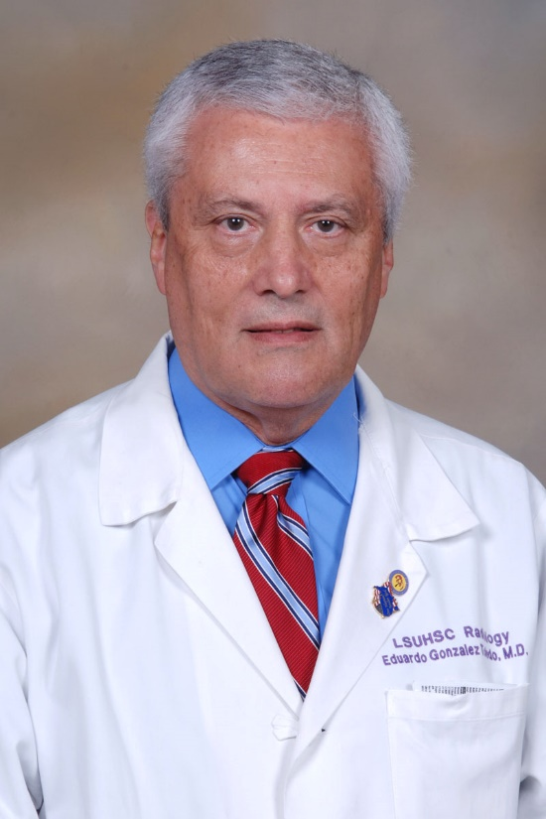

Faculty
Eduardo González-Toledo MD,PhD
Professor of Radiology, Neurology and Anesthesiology
LSU School of Medicine
Louisiana USA
Director of Neuroradiology and Research
Department of Radiology
Ochsner-LSU Health

Slide 3
DTI ( Diffusion tensor Imaging)
Tractography
Fractional anisotropy and color map
Measurements in white matter tracts:
Fractional anisotropy (integrity of bundles)
Parallel diffusivity (axonal integrity)
Perpendicular diffusivity (myelin integrity)

Slide 4
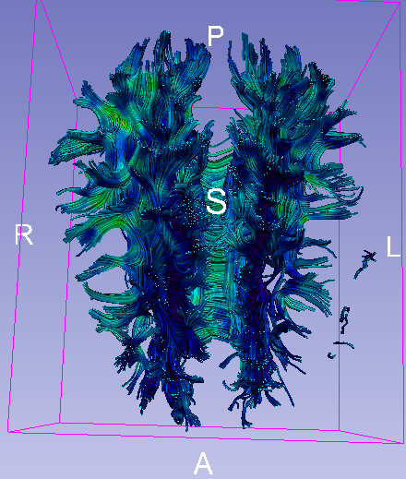
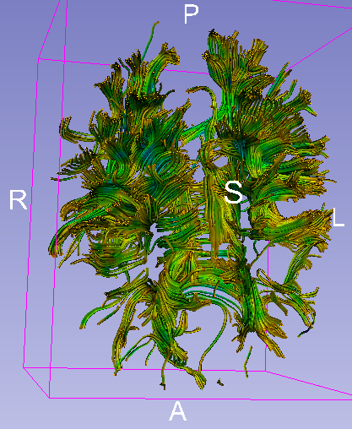
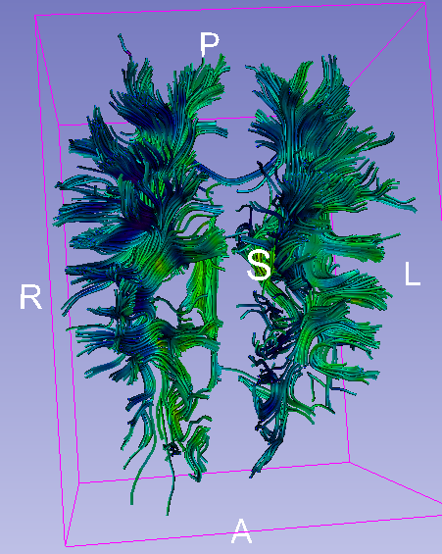
DTI: fiber tracking
Normal
MS
MS chronic

Slide 5
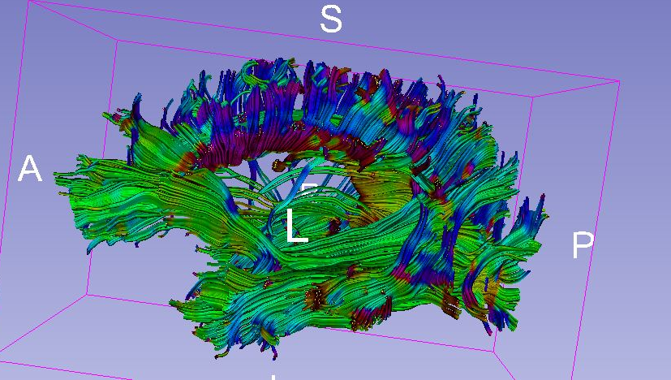
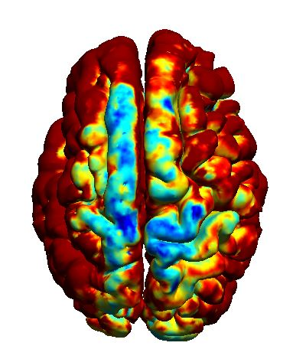
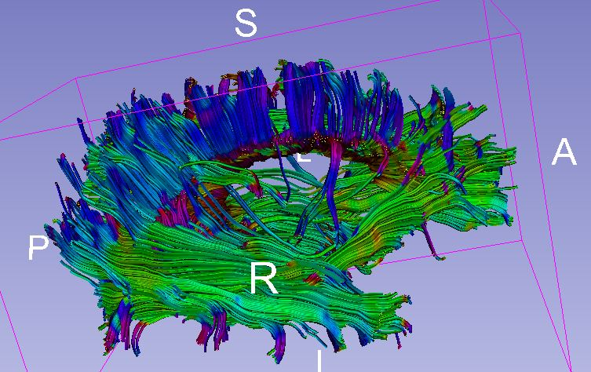
Dysplastic cortex
Poor development of arcuate fasciculus

Slide 6
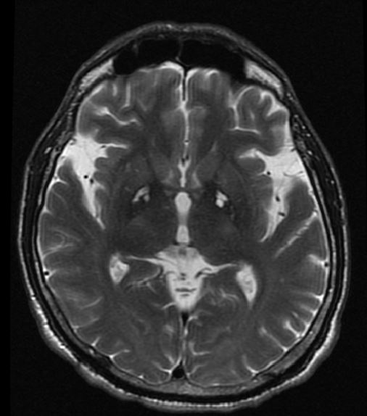
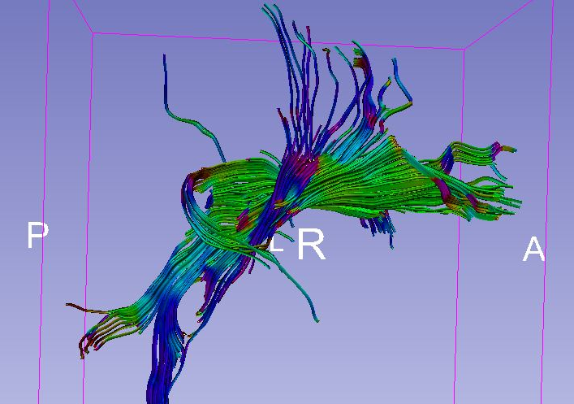
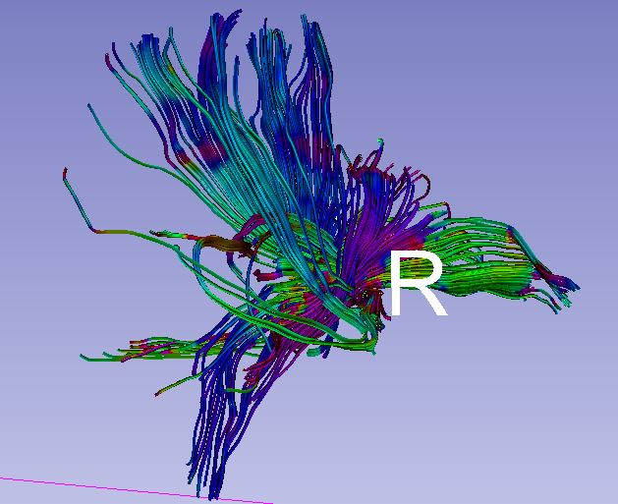
CO poisoning
Patient
Control

Slide 7
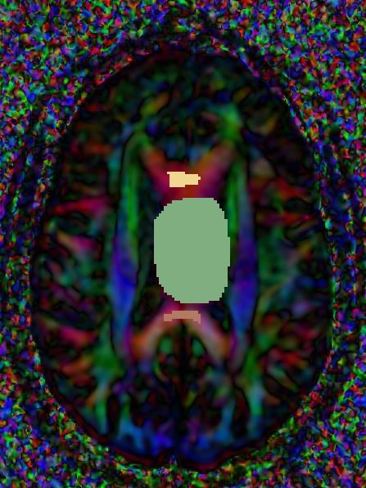
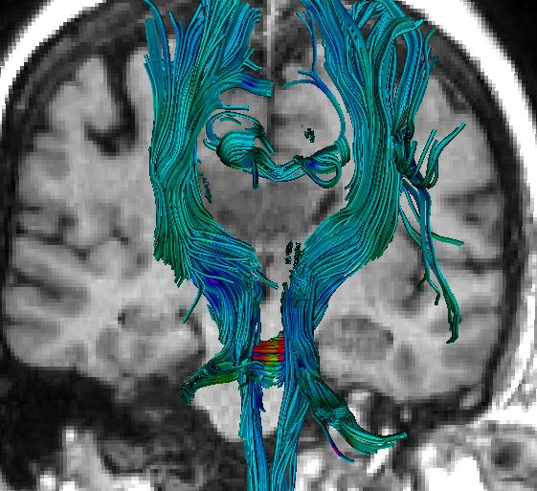
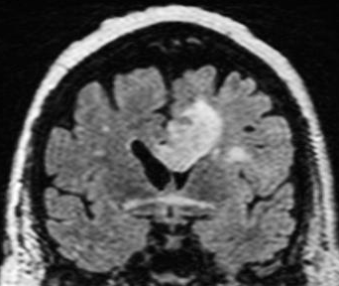
ROI | FA
Mass | 0.245425
Genu c.callosum | 0.597522
Splenium c. callosum | 0.725616
GBM

